Slide 1
Agile Project Management
Information Technology Project Management, Seventh Edition

Slide 2
Agile Project Management
“Gartner predicts that by the end of 2012, agile development will be used on 80% of all software development projects.”
What does this mean?
Why is it gaining popularity?
Gaining ground in PM community with certifications
APMG-International
PMI – Agile Certified Practitioner
Certified Scrum Master

Slide 3
Agile Makes Sense for Some Projects, But Not All
“Agile will be seen for what it is … and isn’t …. Project management organizations embracing Agile software and product development approaches will continue to grow while being faced with the challenge of demonstrating ROI through Agile adoption.”*
When not to use Agile PM
*J. Leroy Ward, “The Top Ten Project Management Trends for 2011,” projecttimes.com
(January 24, 2011).

Slide 4
Agile Makes Sense for Some Projects, But Not All
Goal (ends) | Not Clear | 4 | 3
 | Clear | 1 | 2
 |  | Clear | Not Clear
 |  | Solution (means)
*Fernandez & Fernandez (2009), “Agile Project Management – Agilism versus Traditional Approach,” Journal of Computer Information Systems.

Slide 5
PM Network: At Odds?
Myths surrounding Agile PM:
Agile is All or Nothing
Impacts are only felt in Development Dept.
PM Principles are at odds with Agile

Slide 6
Manifesto for Agile Software Development
“We are uncovering better ways of developing software by doing it and helping others do it. Through this work we have come to value:
Individuals and interactions over processes and tools
Working software over comprehensive documentation
Customer collaboration over contract negotiation
Responding to change over following a plan
*Agile Manifesto, www.agilemanifesto.org.

Slide 7
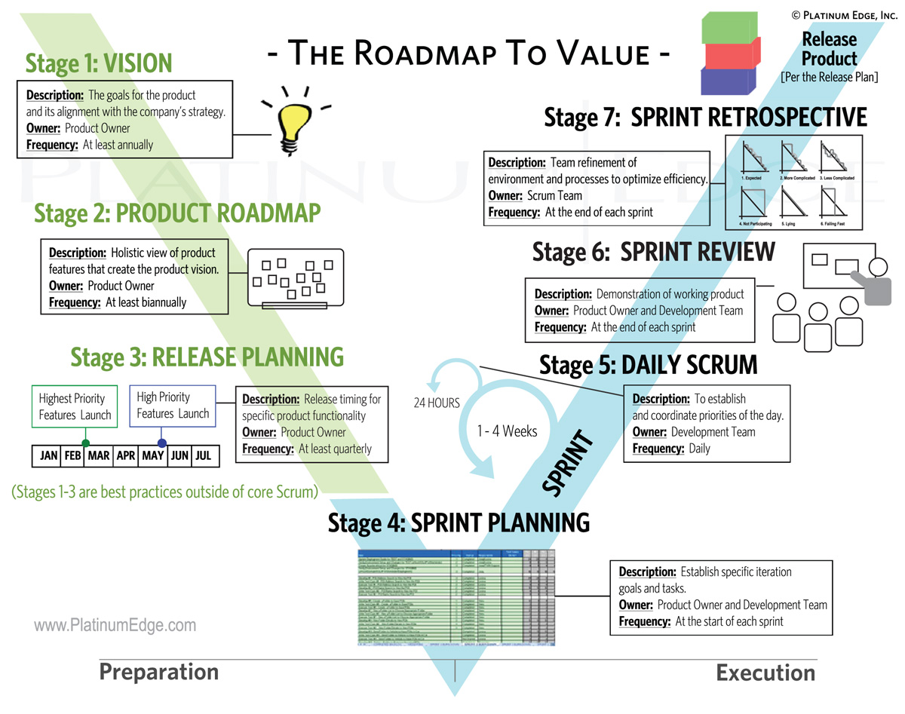
From: https://platinumedge.com/blog/agile-roadmap-to-value

Slide 8
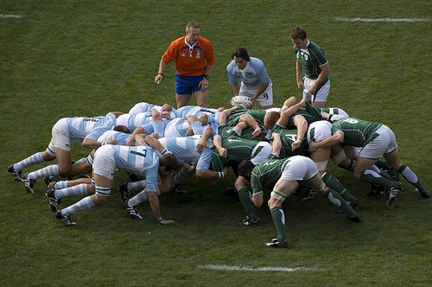
Scrum
According to the Scrum Alliance, Scrum is the leading agile development method for completing projects with a complex, innovative scope of work. (State of Scrum Report)

Slide 9
Scrum Roles
Primary Roles
Product owner
ScrumMaster
Scrum team or development team
Other potential Roles
Stakeholders
Agile mentor

Slide 10
Scrum Artifacts
An artifact is a useful object created by people
Scrum artifacts include:
Product backlog
Sprint backlog
Burndown chart

Slide 11
Scrum Ceremonies
Sprint planning session
Daily Scrum
Sprint reviews
Sprint retrospectives

Slide 12
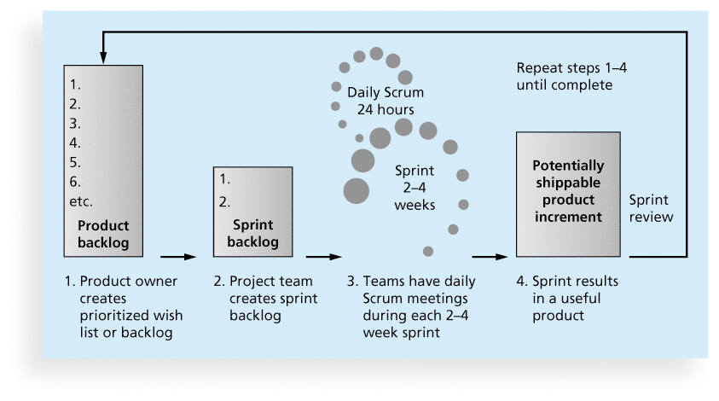
Scrum Framework

Slide 13
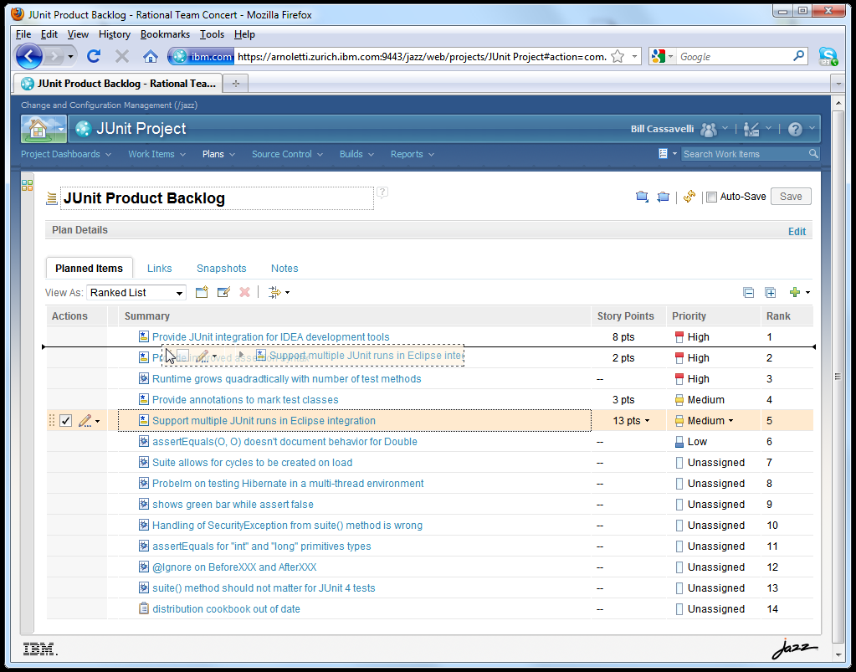
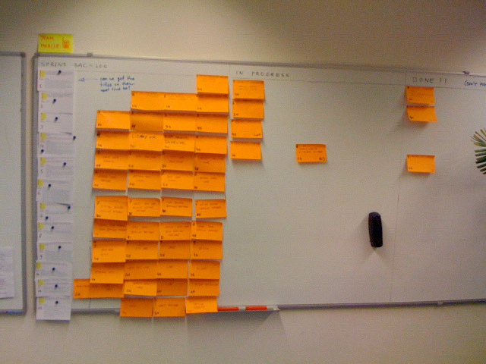
Product Backlog

Slide 14
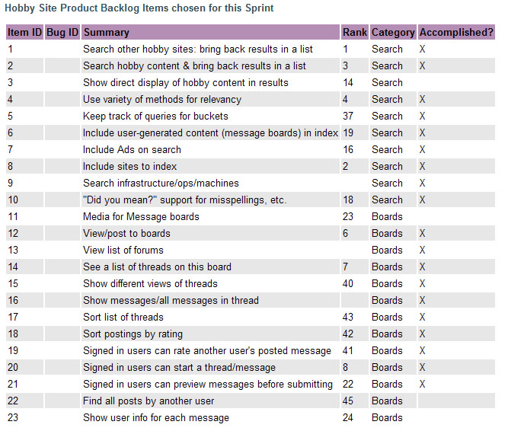
Sprint Backlog

Slide 15
Product vs. Sprint Backlog
Item | Product Backlog | Sprint Backlog
Level of detail | Less detailed | Very detailed
Estimation units | Story Points | Hours
Document ownership | Product Owner | Team
Revised | Weekly | Daily
Duration | Project | Sprint
Workbook | Product Backlog workbook | Iteration Backlog workbook

Slide 16
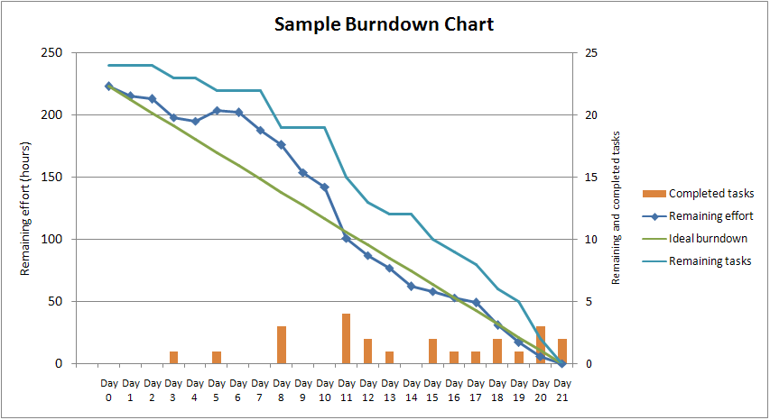
Burndown Chart

Slide 17
PM Network: Agile to the Rescue
How was this an Agile Project?
What does Holacracy mean in projects?
What were some of the roadblocks to using Agile methodologies in Chile?

Slide 18
Agile, the PMBOK® Guide, and a New Certification
The PMBOK® Guide describes best practices for what should be done to manage projects.
Agile is a methodology that describes how to manage projects.
The Project Management Institute (PMI) recognized the increased interest in Agile, and introduced a new certification in 2011 called Agile Certified Practitioner (ACP).

